Slide 1
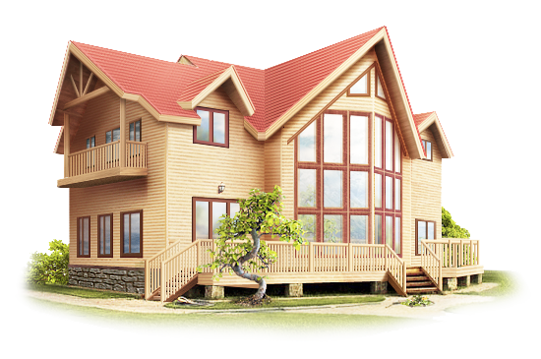
THE HOUSE OF MY DREAM

Slide 2
1 There’s no place 2 Every bird 3 He has no home 4 It’s good to be visiting, 5 Every dog 6 An Englishmen’s house 7 Dry bread at home 8 Men make houses, | is better than roast meat abroad whose home is everywhere like home but it’s better at home likes its own nest women make homes is his castle is a lion at home
На своей печи – сам себе голова Всяк кулик свое болото хвалит Мужчины строят дома, а женщины создают уют У того нет дома, у кого он везде В гостях хорошо, а дома лучше Всяк кулик на своем болоте велик В гостях хорошо, а дома лучше Дома и солома съедома

Slide 3
There’s no place like home.
В гостях хорошо, а дома лучше
Every bird likes its own nest.
Всяк кулик свое болото хвалит
He has no home whose home is everywhere.
У того нет дома, у кого он везде
It’s good to be visiting, but it’s better at home
В гостях хорошо, а дома лучше
Every dog is a lion at home
Всяк кулик на своем болоте велик
An Englishmen’s house is his castle
На своей печи – сам себе голова
Dry bread at home is better than roast meat abroad
Дома и солома съедома
Men make houses, women make homes
Мужчины строят дома, а женщины создают уют

Slide 4
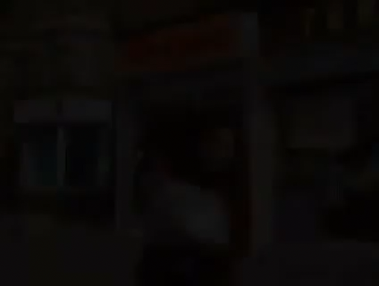
Types of Houses

Slide 5


Slide 6
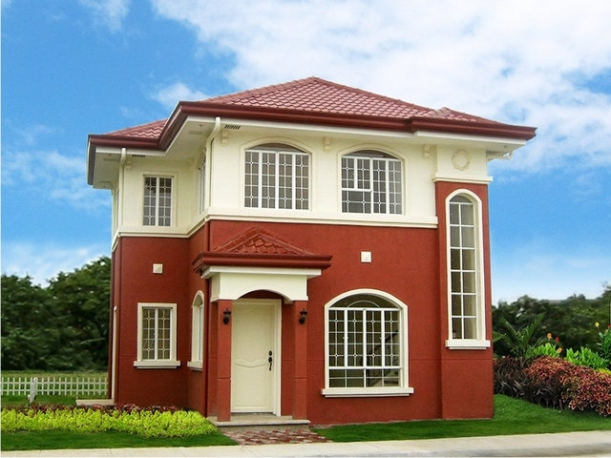
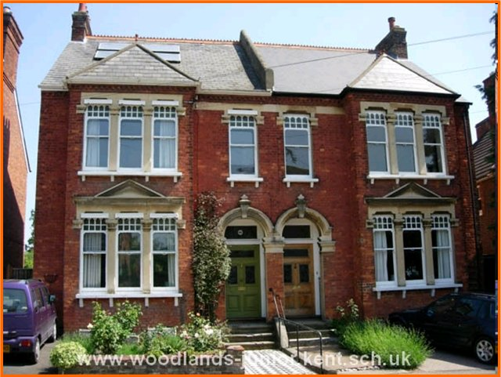
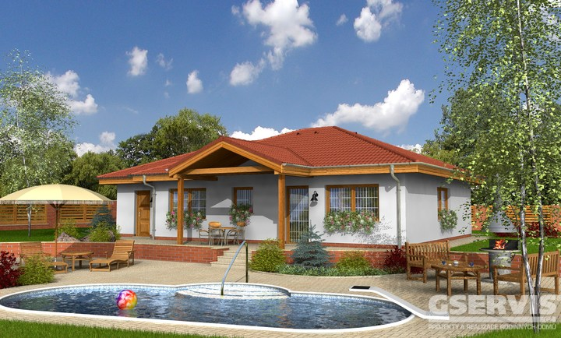
House is not joined to another house
detached house
semi-detached house
bungalow

Slide 7
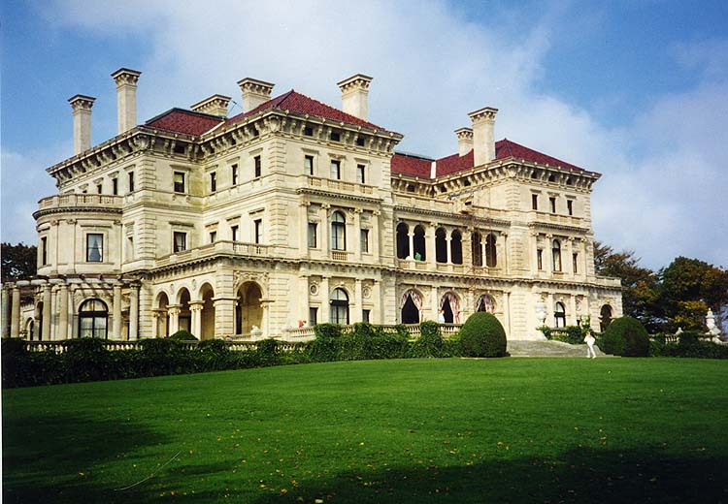
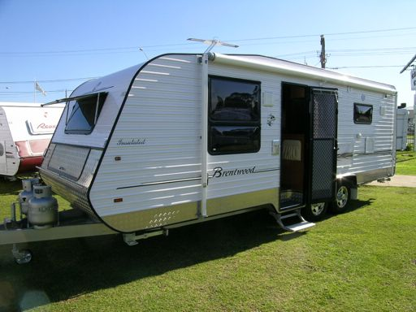
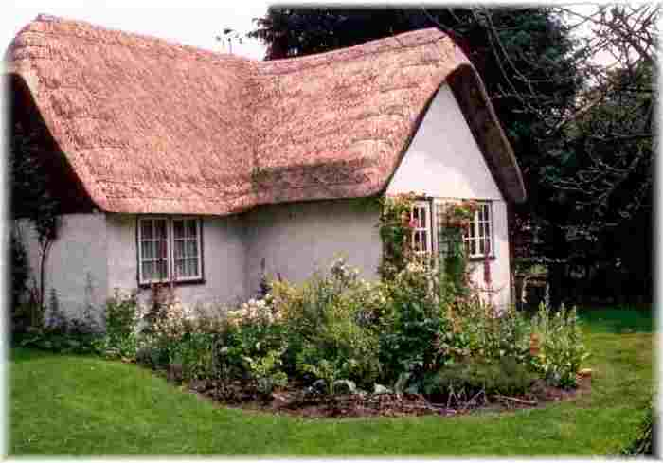
A small house in the country
mansion
caravan
cottage

Slide 8
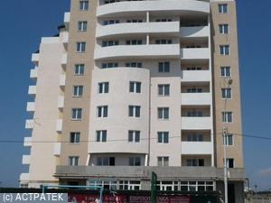
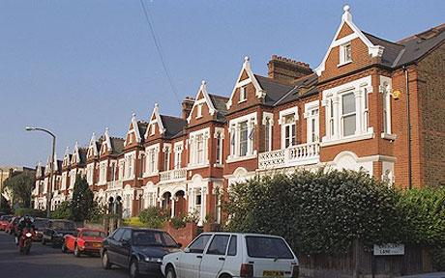
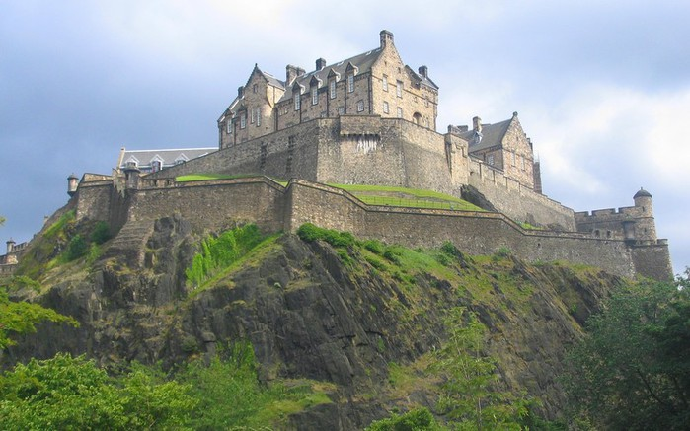
A large building divided into a lot of homes, offices
block of flats
terraced house
mansion
castle

Slide 9
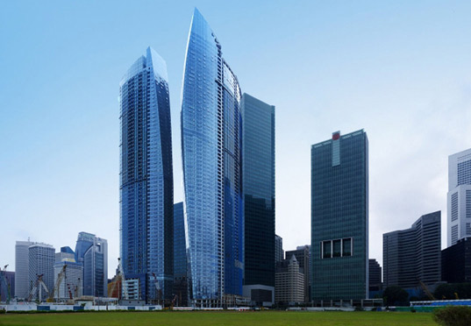
A very tall building
caravan
semi-detached house
skyscraper
terraced house
bungalow

Slide 10

A building with high walls, built in the past to protect the people inside from attack
mansion
block of flats
detached house
cottage
skyscraper
castle

Slide 11
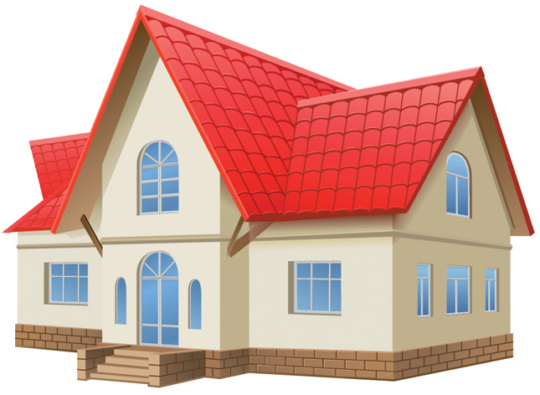
“a house”
“a home”

Slide 12
A home is a building that is made for people to live in
A house is the place where you live or where you feel that you belong

Slide 13
1. Mary has a big ____ in the centre of the town. (house/ home)
2. Berezniki is my ____ town. (house/home)
3. I’m Russian, but now I live in Britain and I missed ____ very much. (house/home)
4. Mr. Housekeeper’s ____ is new and nice. (house/ home)
5. How many rooms are there in your _____? (house/ home)
6. My ____ is a place where I relax and rest. (house/home)

Slide 14
What is home?
A roof to keep out the rain. Four walls to keep out the wind. Floors to keep out the cold.
Yes, but home is more than that. It is the laugh of a baby, the song of a mother, the strength of a father. Warmth of living hearts, light from happy eyes, kindness, loyalty, comradeship.
Home is first school and first church for young ones, where they learn what is right, what is good and what is kind. Where they go for comfort when they are hurt or sick.
Where joy is shared and sorrow eased. Where fathers and mothers are respected and loved. Where children are wanted. Where the simplest food is good enough for kids because it is earned. Where money is not so important as loving kindness. Where even the tea kettle sings from happiness.
That is home.

Slide 15
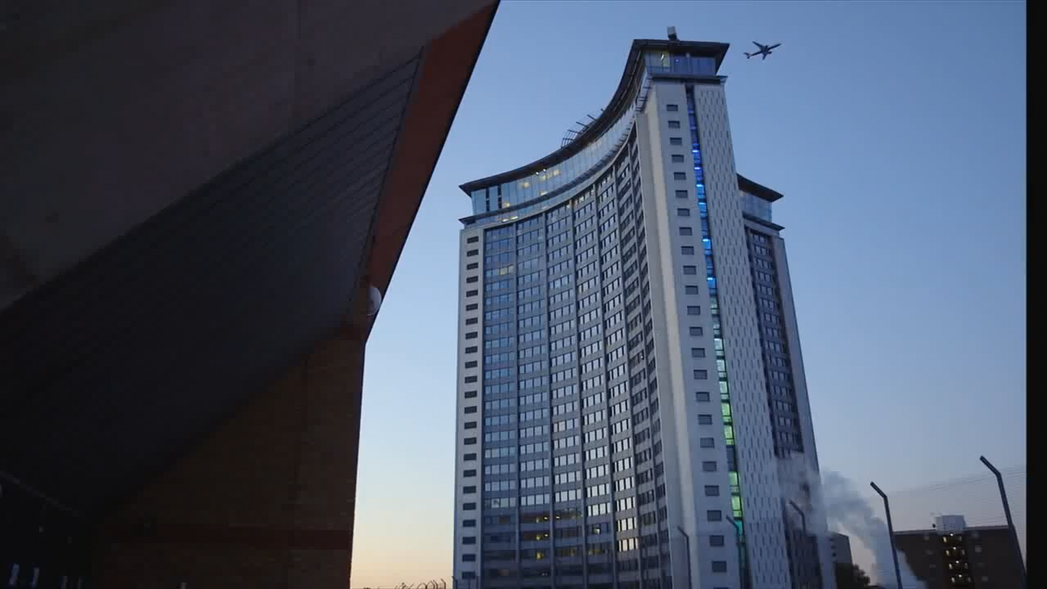
Houses in Future

Slide 16
What kind of homes will we live in the future? What kind of technology will we have?
1 I would love a self-cleaning house 2 I'd like an eco-house 3 I'd like a front door 4 I'd like a TV in each room 5 I'd like a robot chef 6 I would love a bed | a. that could cook all my meals for me. b. so I could watch the football everywhere. c. that does all the housework for me. d. with a fingerprint scanner for security. e. that automatically makes itself every morning. f. that uses renewable energy.

Slide 17
What kind of homes will we live in the future? What kind of technology will we have?
1 I would love a self-cleaning house 2 I'd like an eco-house 3 I'd like a front door 4 I'd like a TV in each room 5 I'd like a robot chef I would love a bed | a. that could cook all my meals for me. b. so I could watch the football everywhere. c. that does all the housework for me. d. with a fingerprint scanner for security. e. that automatically makes itself every morning. f. that uses renewable energy.

Slide 18
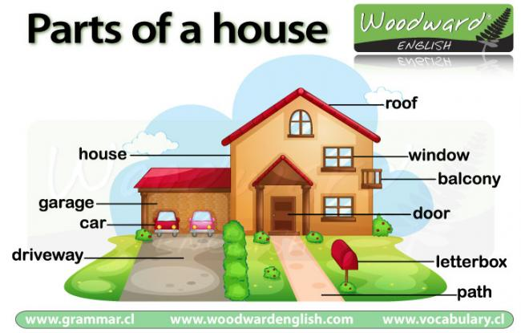

Slide 19
The house of my dream

Slide 20
Ecological clean area
Walls
Roof
Windows
The house of my dream
Furniture
Big rooms
Balcony
Stairs
Garden
Big terrace

Slide 21


Slide 22
House
Household - домашнее хозяйство/ домочадцы (мука грубого помола)
Housemaid - горничная
To house – предоставлять жилище, поселить/ приютить
Housing - снабжение жилищем, жилищное строительство
Housekeeper=housewife - домохозяйка, экономка/ домоправительница
Housing project – проект дома
House-top (roof) - крыша дома
House to house - дом к дому
House-dog – сторожевой пес
House father – глава семьи
House holder - съемщик квартиры, глава семьи
Houseful - полный дом
House agent – комиссионер по продаже и сдаче внаём домов
Houseboat - плавучий дом- лодка
House warming – домашнее тепло
House-fly – комнатная муха
House party – компания гостей, проводящая несколько дней в загородном доме

Slide 23
Home
Homesick- тоскующий по дому, по родине
Home-keeping - домоседливый
Feel at home – чувствовать как дома
Homestead- усадьба, ферма
Homeland= motherland – отечество, родина
Make oneself at home – располагаться как дома
Hometown (where a person lives or was born) – родной город
Homework – домашняя работа
Homecoming –возвращение домой
Come home – приходить домой
Homeless - бездомный
Home from home – из дома в дом
Home made –домашнего приготовления, отечественного производства
Homelike, homely –домашний, уютный, простой обыденный
At home - дома
Home for the elderly – дом для престарелых

